Slide 1
Vision Transformer (ViT)
Shusen Wang
Stevens Institute of Technology
http://wangshusen.github.io/

Slide 2
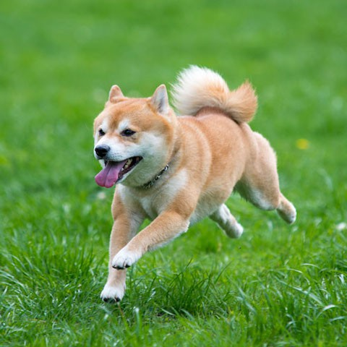
What is in the image?

Slide 3
Neural Network
𝐩

Slide 4
Neural Network
𝐩
Confidence
0.4
0.2
0.12
0.06
0.06
0.07
0.05
0.04
Classes
bird
car cat dog fox jet snake
tiger

Slide 5
Image Classification
CNNs, e.g., ResNet, were the best solutions to image classification.
Vision Transformer (ViT) [1] beats CNNs (by a small margin), if the dataset for pretraining is sufficiently large (at least 100 million images).
ViT is based on Transformer (for NLP) [2].
Reference
Dosovitskiy et al. An image is worth 16×16 words: transformers for image recognition at scale. In ICLR, 2021.
Vaswani et al. Attention Is All You Need. In NIPS, 2017.

Slide 6
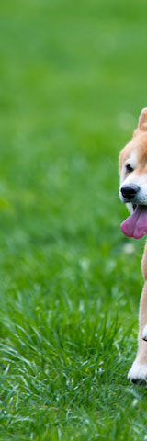
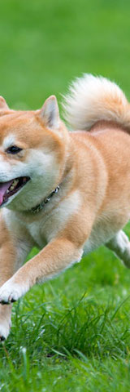
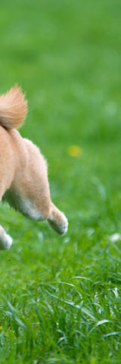
Split Image into Patches

Slide 7

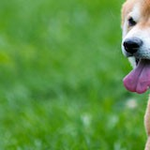
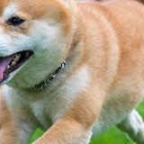
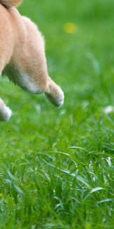
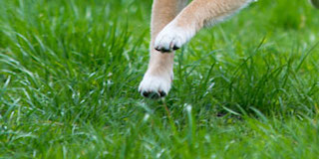
Split Image into Patches
Here, the patches do not overlap.

Slide 8
Split Image into Patches
Here, the patches do not overlap.
The patches can overlap.
User specifies:
patch size, e.g., 16×16;
stride, e.g., 16×16.

Slide 9
Vectorization

Slide 10



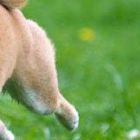
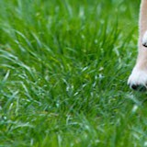
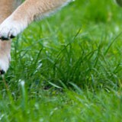
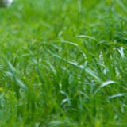
Vectorization

Slide 11
Vectorization
If the patches are 𝑑₁×𝑑₂×𝑑₃ tensors, then the vectors are 𝑑₁𝑑₂𝑑₃×1.
𝐱₁
𝐱₂
𝐱₃
𝐱₄
𝐱₅
𝐱₆
𝐱₇
𝐱₈
𝐱₉

Slide 12
𝐱_{𝑛}
𝐱₁
𝐱₂
𝐱₃
⋯

Slide 13

𝐳₁ = 𝐖 𝐱₁ + 𝐛
Dense
𝐱₁
𝐱₂
𝐱₃
⋯
𝐱_{𝑛}

Slide 14
𝐳₂ = 𝐖 𝐱₂ + 𝐛
𝐳₁
Dense
Dense
𝐱₁
𝐱₂
𝐱₃
⋯
𝐱_{𝑛}

Slide 15
𝐳₁
𝐳₂
𝐳₃
⋯
𝐳_{𝑛}
⋯
Share Parameters
Dense
Dense
Dense
Dense
𝐱₁
𝐱₂
𝐱₃
⋯
𝐱_{𝑛}

Slide 16
1
2
3
𝑛
Positional Encoding:
⋯
𝐳₁
𝐳₂
𝐳₃
⋯
𝐳_{𝑛}
Dense
Dense
Dense
⋯
Dense
𝐱₁
𝐱₂
𝐱₃
⋯
𝐱_{𝑛}

Slide 17
Add positional encoding vectors to 𝐳₁, 𝐳₂, ⋯ , 𝐳_{𝑛}.
⋯
𝐳₁
𝐳₂
𝐳₃
⋯
𝐳_{𝑛}
Dense
Dense
Dense
⋯
Dense
𝐱₁
𝐱₂
𝐱₃
⋯
𝐱_{𝑛}

Slide 18
Add positional encoding vectors to 𝐳₁, 𝐳₂, ⋯ , 𝐳_{𝑛}. (Why?)
𝐳₁
𝐳₂
𝐳₃
⋯
𝐳_{𝑛}
Dense
Dense
Dense
⋯
Dense
𝐱₁
𝐱₂
𝐱₃
⋯
𝐱_{𝑛}

Slide 19

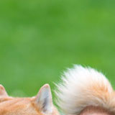




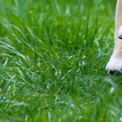
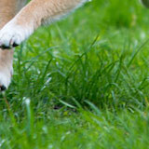
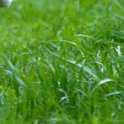
Add positional encoding vectors to 𝐳₁, 𝐳₂, ⋯ , 𝐳_{𝑛}. (Why?)
𝐳₁
𝐳₂
𝐳₃
⋯
𝐳_{𝑛}
Dense
Dense
Dense
⋯
Dense
𝐱₁
𝐱₂
𝐱₃
⋯
𝐱_{𝑛}

Slide 20
Add positional encoding vectors to 𝐳₁, 𝐳₂, ⋯ , 𝐳_{𝑛}. (Why?)
① ③
②
𝐳₁ 𝐳₂ 𝐳_{3 ⋯} 𝐳_{𝑛}
Dense Dense Dense ⋯⋯ Dense
^{𝐱}1 ^{𝐱}2 ^{𝐱}3 ⋯ ^{𝐱}𝑛
④
⑤ ⑥
⑦ ⑧
⑨

Slide 21
Add positional encoding vectors to 𝐳₁, 𝐳₂, ⋯ , 𝐳_{𝑛}. (Why?)
①
②
③
① ③
②
𝐳₁ 𝐳₂ 𝐳_{3 ⋯} 𝐳_{𝑛}
Dense Dense Dense ⋯⋯ Dense
^{𝐱}1 ^{𝐱}2 ^{𝐱}3 ⋯ ^{𝐱}𝑛
④
⑤
⑥
④
⑤ ⑥
⑦
⑧
⑨
⑦ ⑧
⑨

Slide 22
𝐳_{𝑛}
𝐳₀
𝐳₁
𝐳₂
𝐳₃
⋯
Embed
Dense
Dense
Dense
⋯
Dense
[CLS]
𝐱₁
𝐱₂
𝐱₃
⋯
𝐱_{𝑛}

Slide 23
⋯
⋯
Dense
Multi-Head Self-Attention
𝐳₀
𝐳₁
𝐳₂
𝐳₃
⋯
𝐳_{𝑛}
Embed
Dense
Dense
Dense
⋯
Dense
[CLS]
𝐱₁
𝐱₂
𝐱₃
⋯
𝐱_{𝑛}

Slide 24
⋯
Dense
Multi-Head Self-Attention Dense
Multi-Head Self-Attention
⋯
⋯
Transformer Encoder Network
𝐳₀
𝐳₁
𝐳₂
𝐳₃
⋯
𝐳_{𝑛}
Embed
Dense
Dense
Dense
⋯
Dense
[CLS]
𝐱₁
𝐱₂
𝐱₃
⋯
𝐱_{𝑛}

Slide 25
𝐜_{𝑛}
𝐜₀
𝐜₁
𝐜₂
𝐜₃
⋯
Transformer Encoder Network
𝐳₀
𝐳₁
𝐳₂
𝐳₃
⋯
𝐳_{𝑛}
Embed
Dense
Dense
Dense
⋯
Dense
[CLS]
𝐱₁
𝐱₂
𝐱₃
⋯
𝐱_{𝑛}

Slide 26
𝐜₀
𝐜₁ 𝐜₂ 𝐜_{3 ⋯} 𝐜_{𝑛}
Transformer Encoder Network
𝐳₀
𝐳₁
𝐳₂
𝐳₃
⋯
𝐳_{𝑛}
Embed
Dense
Dense
Dense
⋯
Dense
[CLS]
𝐱₁
𝐱₂
𝐱₃
⋯
𝐱_{𝑛}

Slide 27
Softmax Classifier
𝐩
𝐜
0
Transformer Encoder Network
𝐳₀
𝐳₁
𝐳₂
𝐳₃
⋯
𝐳_{𝑛}
Embed
Dense
Dense
Dense
⋯
Dense
[CLS]
𝐱₁
𝐱₂
𝐱₃
⋯
𝐱_{𝑛}

Slide 28
Softmax Classifier
𝐩
𝐜
0
Confidence
0.4
0.2
0.12
0.06
0.06
0.07
0.05
0.04
Classes
bird
car cat dog fox jet snake
tiger

Slide 29


Randomly Initialized
Pretrained
Dataset A

Slide 30




















































Randomly Initialized
Pretrained
Fine-tuned
Training Set of Dataset B
Dataset A

Slide 31




Randomly Initialized
Pretrained
Fine-tuned
Test Accuracy
Training Set of Dataset B
Test Set of Dataset B
Dataset A

Slide 32
Datasets
 | # of Images | # of Classes
ImageNet (Small) | 1.3 Million | 1 Thousand
ImageNet-21K (Medium) | 14 Million | 21 Thousand
JFT (Big) | 300 Million | 18 Thousand

Slide 33
Image Classification Accuracies
Pretrain the model on Dataset A, fine-tune the model on Dataset B, and evaluate the model on Dataset B.
Pretrained on ImageNet (small), ViT is slightly worse than ResNet.
Pretrained on ImageNet-21K (medium), ViT is comparable to ResNet.
Pretrained on JFT (large), ViT is slightly better than ResNet.

Slide 34
Image Classification Accuracies
ResNet is better
ViT is better
# of Images for pretraining
100M
Images
300M
Images

Slide 35
Thank You!
http://wangshusen.github.io/

